Slide 1
Collaborative work for Hi-ASAP
Topic: Characterization of fine particulate matter (PM_{1.0} and PM_{2.5}) from incense burning in temples in Asian countries
To Thi Hien et al.
Faculty of Environment, University of Science, Vietnam National University, Ho Chi Minh City
12 Oct 2021
1

Slide 2
Background
- Incense stick burning is one of common and popular ritual in East and Southeast Asian countries, including Vietnam
Incense burning generates many gaseous and particulate pollutants, especially fine particles (PM_{1.0}, PM_{2.5})
→ It is important to study fine particles emitted from incense burning and personal exposure to PM
2

Slide 3
Objectives
To assess and compare concentration levels of fine particles from incense burning in the temples (PM_{1.0} and PM_{2.5}) in Asian countries
Calculating exposure to PM₁ and PM_{2.5} from incense burning
If possible: OC/EC
3

Slide 4
Methods
Measure PM_{1.0} and PM_{2.5} in temples using low-cost sensors
Collect PM_{2.5} for determine OC/EC
Instrument: AS-LUNG or other sensors (sensors need to be calibrated)
Site: 1 - 2 temples in the city
Timeline: monitor PM twice per month:
The 1st and the full moon day (15th) of lunar month
2 days before and 2 days after the 1st and the 15th of lunar month
4 hours in the morning (7:30 – 11:30)
4 hours in the afternoon (13:45 – 17:45)
4

Slide 5
Monitor PM by sensor (AS-LUNG is the best):
Mobile: Research staff will carry AS-LUNG in front of their chest or on their shoulder and move around the temple for 4 hours, and count number of incense stick per 30 min (average 1 stick will burn during 30 min)
Fixed: measure the concentration of PM outside at the temple gate next to street where there are traffic activity, and count number of worshipper every 1 hour
Resolution: 1 min
Sampling PM_{2.5} by impactor sampler to analysis OCEC
Fixed: using impact sampler (quartz filter) to collect PM_{2.5} during 4 hours in the morning and in the afternoon
5

Slide 6
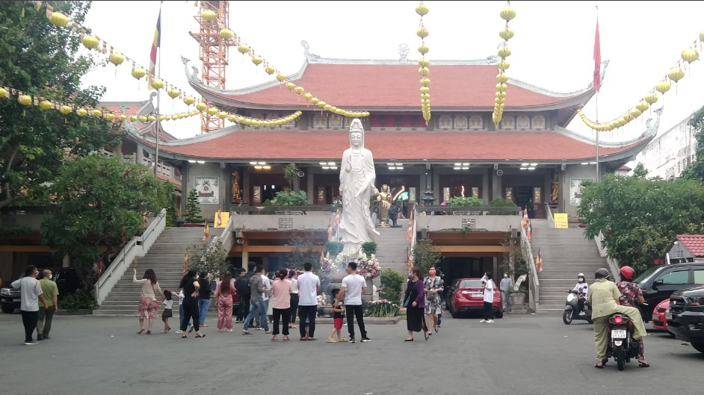
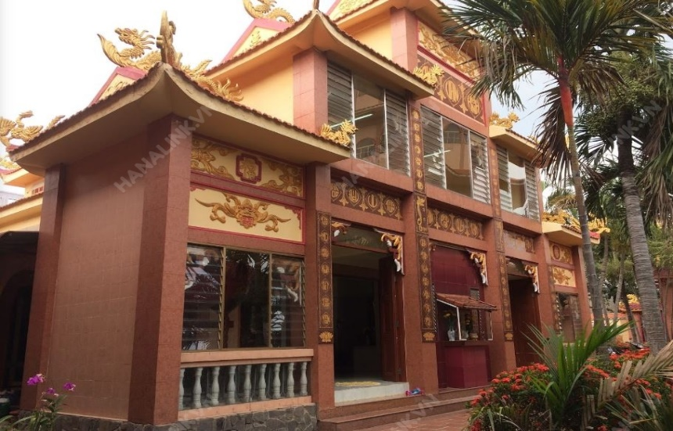
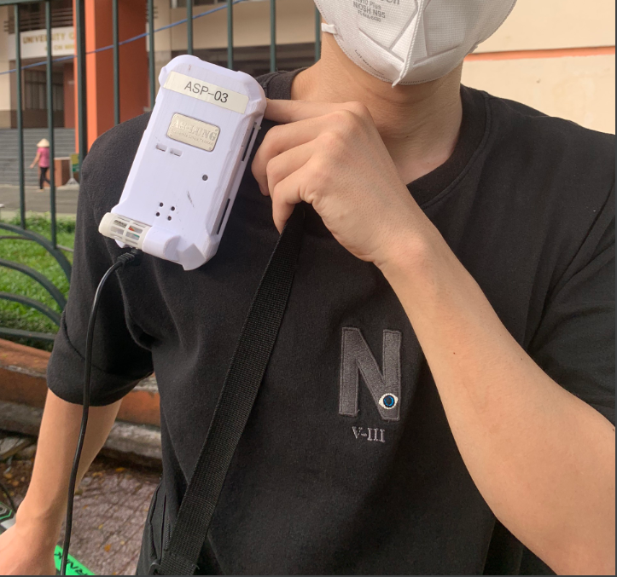
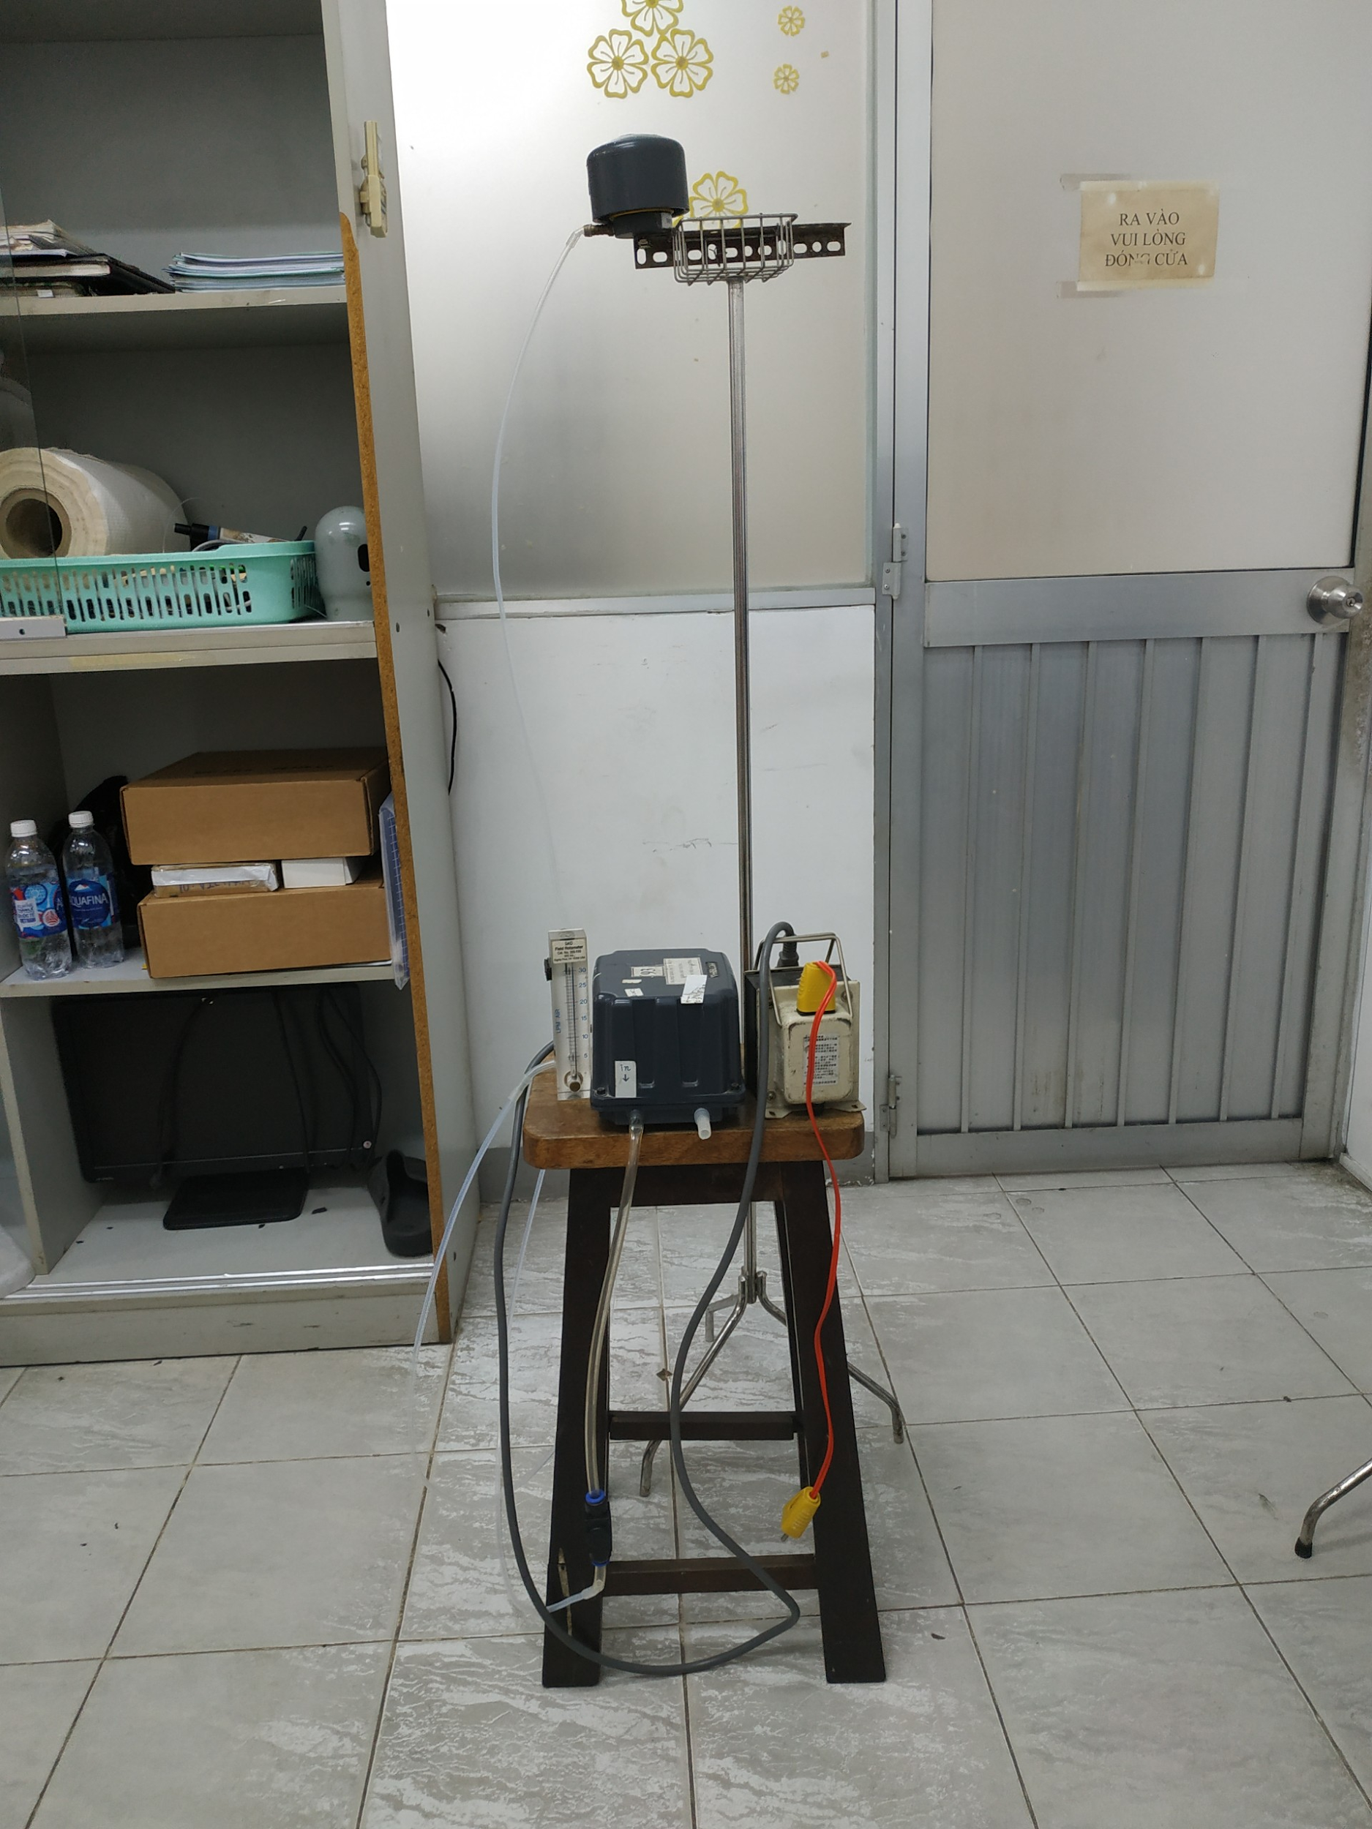
Temple 1
Temple 2
Impact Sampler
6
Worshipper

Slide 7
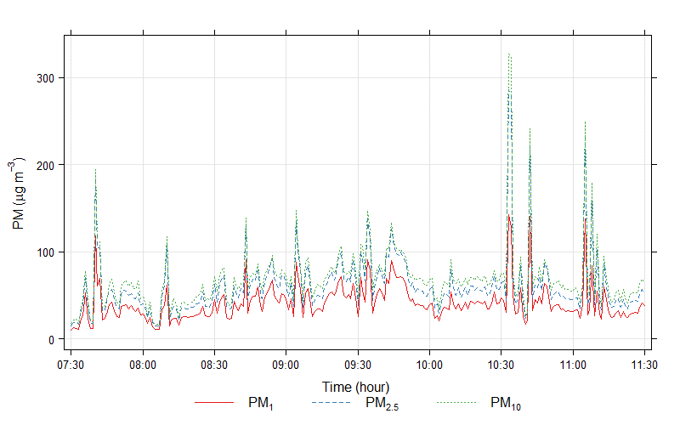
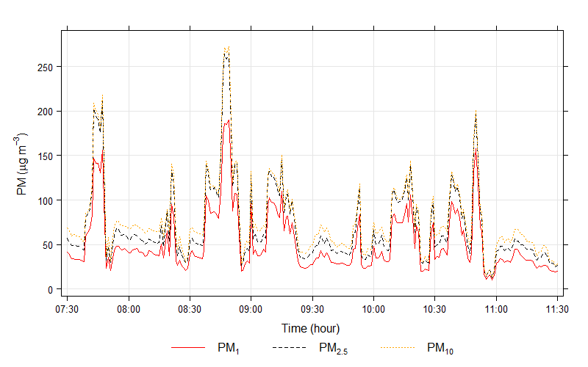
Some initial results…
Research staff was standing near the incensory
Temple 1
Temple 2
7

Slide 8
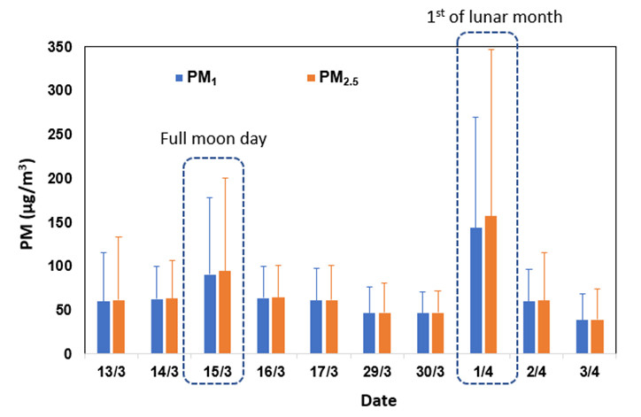
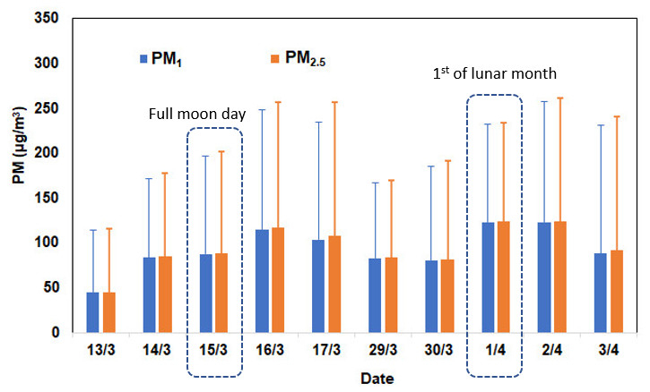
PM₁, PM_{2.5} on full moon day (15th)/1st of lunar month and on 2 days before and after
9

Slide 9
Thank you for your attention!
9

